Slide 1
Indexer Workflow

Slide 2
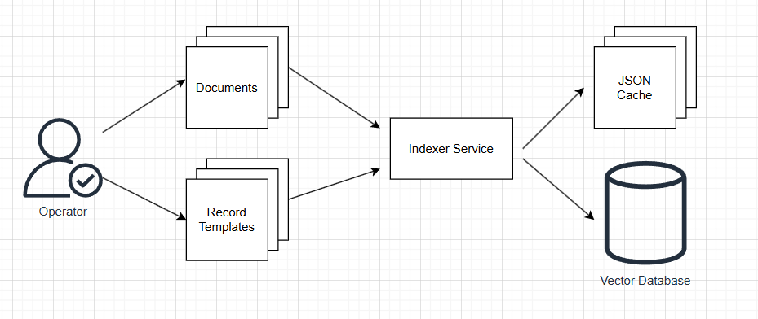
High-Level Indexer Service Design

Slide 3
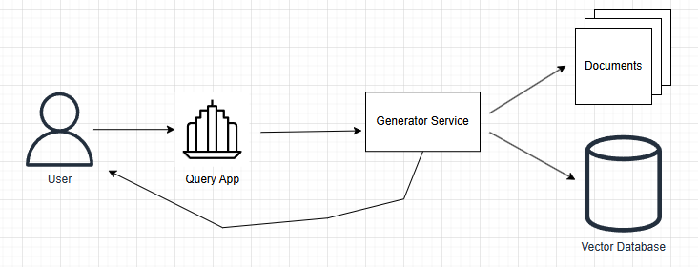
High-Level Query App Design

Slide 4
Indexer Architecture
Two workflows:
Operator extracts data
User queries data and fetches relevant documents
Operator is a privileged role to protect data integrity.
User is a authenticated role. Access to data is granted based on role.

Slide 5
Documents are Source of Truth
Documents are the only source of truth. All other components can be recreated from the documents.
This principle allows the system to be platform agnostic and allows to avoid portability problems of vector storage and service implementation.
All platforms (on-premise, AWS, Azure, GCP) have components of the system implemented already.

Slide 6
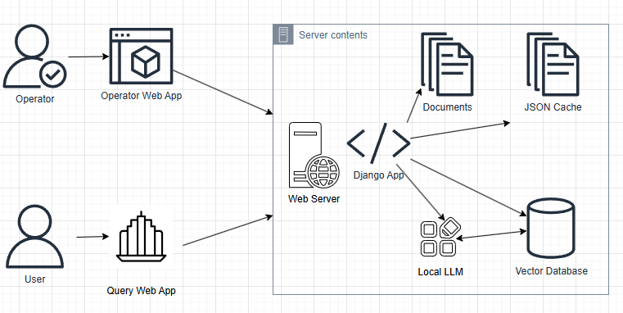
On-premise Architecture

Slide 7
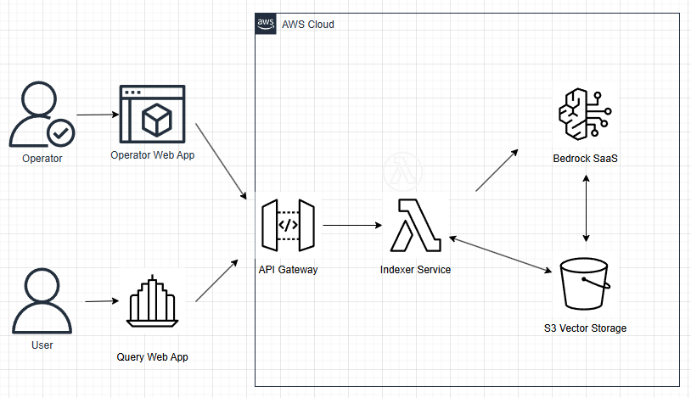
AWS Architecture

Slide 8
Risk Factors
 | On-prem / IaaS | SaaS | REST API
Data control
Capital Expense
Operational Expense
Scalability
Portability

Slide 9
Performance Notes
Performance of on-premise solution depends on the server configuration.
SaaS solutions allow to buy performance guarantees
REST API solutions are subject to rate limits of the vendor

